Slide 1
Noções Básicas de NMS

Slide 2
Network management system (NMS) is an important part of a communications system. This document describes the basic architecture of the NMS, communication modes and interactions between the NMS and NEs, and the development history and basic functions of the NMS used by Huawei access network system.

Slide 3
After this course, you will be able to:
Describe the basic architecture of an NMS.
Describe the communication modes and interactions between the NMS and NEs.
Describe the SNMP setting requirements.
Describe the basic functions and operations of Huawei U2000, NCE (Access Domain), and eSight PON NMS.

Slide 4
NMS Architecture
SNMP
Overview of Huawei Access NMSs
eSight
iManager U2000
NCE (Access Domain)

Slide 5
Background
In network management, the devices in a network are managed to support the normal, cost-effective, reliable, and secure operation of the communications network, so that effective, reliable, and secure communication services can be provided. Network management is an important part of a communications network.
We cannot manage an entire large-scale network only by manual operations, which necessitates the emergence of an NMS.
Devices and resources to be managed by the NMS may come from different vendors.
An NMS aims to provide more intelligent network management services with less manpower, equipment, and capital.

Slide 6
Basic NMS Functions
Fault management
Fault management is used to detect and determine faults in the network environment. Faults can be identified by detecting abnormal events, recorded in logs, and traced, diagnosed, and tested based on fault symptoms.
Fault management includes fault detection, fault diagnosis, fault rectification, and fault recording.
Performance management
Performance management evaluates the long-term performance and controls it at an acceptable level.
Performance management involves the following functions: selecting detection objects and modes, collecting and analyzing statistics, providing useful network performance reports, and adjusting networks based on data to control network performance.
Security management provides a security policy to ensure that only authorized users can access restricted network resources.
The security of the NMS can be divided into two layers: the security of the devices and the security of the NMS.
Security management methods: user permission management, user login management, and log management.
Security management
Configuration management
Configuration management monitors network configuration information so that network administrators can generate, query, and modify hardware and software running parameters and conditions, and configure services.
Charging management
Charging management monitors and records users' network resource usage and allocates network operating costs.
The main functions of charging management are as follows: collecting charging records, calculating user bills, allocating network operation costs, and budgeting network operations.

Slide 7

NMS Architecture
Client 1
Client 2
Client 3
An NMS can use the client/server (C/S) or browser/server (B/S) architecture.
To enable the server to manage NEs, the communication between the server and NEs over the SNMP and Telnet/STelnet protocols must be normal.
Clients are connected to the server through the LAN, receives user requests, and interacts with the server. Therefore, the clients must be able to communicate with the server normally.
Server
Network

Slide 8
B/S and C/S Architectures
C/S architecture
In the C/S architecture, the server manages data, and the client interacts with users.
Compared with the B/S architecture, the maintenance and upgrade are more difficult.
Built on a dedicated network, the C/S architecture is oriented to relatively fixed user groups, offering high information security.
Request
Client
Server
Response
B/S architecture
The B/S architecture enables data exchange with the database through the web server over a browser on a computer or mobile phone while core service processing can be completed on the server.
The maintenance and upgrade modes are simpler. The browser basically does not need to be maintained. Only the server needs to be upgraded and maintained.
The B/S architecture is built on the WAN and is applicable to a wide range of scenarios.
Browser on the client
HTTP request
Web
server
Query
Database
server
HTTP response
Result
Notes:
Huawei U2000 uses the C/S architecture, and eSight and NCE use the B/S architecture.

Slide 9
Implementation Modes (1) - Inband Network Management
In inband network management mode, the management and control information and the service information are transmitted through the same logical channel. That is, the NMS information and the service share the bandwidth. In this manner, the general NMS functions such as network monitoring and management and traffic analysis can be implemented.
The networking for this mode is flexible and requires no additional devices. Therefore, the investment is low. Currently, most telecommunication networks use this mode.
The management channel depends on the managed devices, which is not reliable enough.
Client 1
Client 2
Client 3
Server
Network
Notes:
When a network fault occurs, if the device is not displayed on the NMS or the fault cannot be rectified on the NMS, you can remotely rectify the fault through Telnet.
The following faults cannot be rectified through Telnet in inband network management mode: Network devices are disconnected from the network due to link interruption. The software of the device is being upgraded. When a device is attacked, the network bandwidth is fully occupied or the CPU usage reaches 100%. In this case, the Telnet process cannot control or manage the device due to bandwidth or CPU processing mechanism (generally, the CPU usage is preferentially allocated to the local console process). When the link of a device needs to be adjusted, the device needs to be disconnected from the network temporarily. Some bottom-layer processes need to be restarted.

Slide 10
Implementation Modes (2) - Outband Network Management
Outband network management means that the management and control information and the service information are transmitted through different logical channels. Dedicated devices are required to connect to the console port of the managed NE to implement centralized maintenance and functions that cannot be implemented by inband network management, such as remote software upgrade and emergency diagnosis and handling of device disconnections.
The networking for outband network management is based on dedicated channels that are set up outside the managed device, which is highly reliable.
It requires additional devices, which means high investment. In addition, it is limited to networks where private lines are deployed, which is not flexible.
Client 1
Client 2
Client 3
Server
Outband network management communication link
Network

Slide 11
Network Management Interfaces
The following table lists the main interfaces between the NMS and NEs.
Interface Type | Interface Description
SNMP interface | One of the basic interfaces for managing network devices. The SNMP interfaces help achieve basic management functions such as automatic NE discovery, service configuration data synchronization, fault management, and performance management. SNMP has three versions: SNMPv1, SNMPv2c, and SNMPv3.
Telnet interface | One of the basic interfaces for managing network devices. The Telnet interfaces, as supplementation of the SNMP interfaces, provide additional management functions. Telnet and STelnet (SSHv2) are supported.
FTP SBI | One of the basic interfaces for managing network devices. Backs up and loads the configuration file and image program of the device through the FTP interface.
Syslog interface | Receives system logs of devices.
NETCONF interface | One of the basic interfaces for managing network devices. Currently, SSH is used as the underlying transmission protocol.

Slide 12
NMS Architecture
SNMP
Overview of Huawei Access NMSs
eSight
iManager U2000
NCE (Access Domain)

Slide 13
SNMP - Basic Concept
Simple Network Management Protocol (SNMP) is a network management protocol widely used in TCP/IP networks. It provides a method for managing network resources by using a central computer (a network management station) that runs the network management software.
SNMP ensures that management information is transmitted between any two points.
It is independent from the managed devices. Both IP devices and ATM devices can be managed through SNMP.
Currently, SNMPv2c and SNMPv3 are commonly used.
Notes:
SNMP has three versions:
SNMPv1: is easy to implement but has poor security.
SNMPv2c: has moderate security and is the most widely used.
SNMPv3: defines a management frame and references the user security model (USM) to provide a secure access control mechanism.

Slide 14
Position of SNMP in the TCP/IP Protocol Stack
FTP
HTTP
SNMP
RIP
Application layer
161/162
TCP
UDP
Transport layer
IP
Network layer
Link-layer protocol
Data link layer
Physical layer
Physical layer
Notes:
SNMP is an application-layer protocol of the TCP/IP network. It is the carrier for communication between the NMS and the agent. Information is exchanged through the protocol data unit (PDU). SNMP does not transmit data. Data exchange is completed by transport layer protocols such as UDP.

Slide 15
SNMP Structure
SNMP defines how to transmit management information between the NMS and the agent.
NMS
UDP Port 162
Request
Response
Trap
UDP Port 161
Managed device
Agent
MIB
Notes:
Through the SNMP protocol, signaling is exchanged between the network management workstation and the agent.
An NMS is network management software that runs on the NMS workstation. Network administrators send requests to managed devices on the NMS to monitor and configure these devices.
An agent is a network management process running on a managed device. After the managed process receives a request from the NMS, the agent provides responses. The agent collects device status information, operates managed devices, and reports alarms to the NMS.
A Management Information Base (MIB) is a virtual database, which is a device status information set maintained on the managed device. An agent searches the MIB to collect device status information. An MIB organizes managed objects based on the hierarchical tree structure and uses the abstract syntax notation one (ASN.1) format to describe managed objects.
When the managed device is abnormal, the agent notifies the NMS of the fault through a trap, which helps the network administrator handle the fault in time.
SNMP network management consists of three parts: MIB, structure management information (SMI), and SNMP.

Slide 16
Management Information Base (MIB)
The MIB is an abstract set of all managed objects (a set of device status information maintained on managed devices). Each agent has a MIB whose object values can be read or set by the NMS.
An MIB is organized in a tree structure, which is called an MIB tree.
Each managed object corresponds to a leaf node in the tree structure.
The NMS manages the device by reading and writing the managed object in the MIB.
Notes:
The MIB is a collection of managed objects. It defines attributes of managed objects, including:
Object identifier (OID)
Object access permission
Data type

Slide 17
Structure of Management Information (SMI)
SMI specifies a set of rules for naming and defining managed objects, specifies how to define and organize managed objects, and defines the object ID, object type, access level, and status of managed objects.
Currently, there are two versions:
SMI v1 (RFC 2578)
SMI v2 (RFC 1155)

Slide 18
SNMP Packet Operations
SNMP application
SNMP application
MIB
2. Get-next-request
3. Set-request
2. Get-next-request
3. Set-request
1. Get-request
4. Get-response
1. Get-request
4. Get-response
5. Trap
5. Trap
SNMP Manager
SNMP Agent
UDP
UDP
IP
IP
Physical network
Physical network
Notes:
SNMPv1 defines five types of PDUs, that is, SNMP packets, for the interaction between the NMS and the agent. The operations of each type of packets are as follows:
Get-request: obtains one or more parameter values from the agent process.
Get-next-request: obtains the next parameter value from the agent process.
Set-request: sets one or more parameter values of the agent process.
Get-response: returns one or more parameter values. This operation is initiated by the agent process and is a response to the preceding three operations.
Trap: proactively sent by an agent process to notify a management process of an event.
SNMPv2c supports the following new operations:
Get-bulk request: The NMS reads a batch of information from the managed device, which is equivalent to multiple get-next operations.
Inform: The managed device sends an alarm to the NMS, and the NMS returns an Inform response to acknowledge the alarm.

Slide 19
SNMP Version Comparison
There are three versions of SNMP: SNMPv1, SNMPv2c, and SNMPv3.
SNMPv3 is similar to SNMPv1 and SNMPv2c in implementation principles. The difference is that SNMPv1 and SNMPv2c use read-only and read-write community names for connection, whereas SNMPv3 uses authentication and encryption for connection, which adds identity authentication and encryption.
Protocol Version | User Authentication | Encryption | Authentication
V1 | No; community names are used. | No | No
V2c | No; community names are used. | No | No
V3 | Yes. User-name-based verification | Yes | Yes
Notes:
SNMPv1 and SNMPv2c both use community name–based authentication. NMS uses the community name list to control the device access permissions, whereas the agent does not check whether the community name used by the sender is authorized. Additionally, SNMP messages are not encrypted for transmission, therefore, security in authentication and privacy is not ensured.
When the connection fails in SNMPv1 and SNMPv2c, check whether the read community name is correct and whether the port number is changed.
SNMPv2c is an enhanced version of SNMPv1. Compared with SNMPv1, SNMPv2c supports more operations, data types, communications protocols, and error handling codes.
SNMPv3 security is ensured by data security and access control.
SNMPv3 provides message-level data security, including data integrity, data source verification, and data verification.
SNMPv3 implements access control based on protocol operations, and controls the access to managed objects.

Slide 20
Basic Configurations (1)
Configuring read and write community names
The snmp-agent community command configures an SNMPv1 or SNMPv2c read/write community name and specifies a MIB view and community name access tag. The undo command cancels the setting of community name access.
Example: To set the community name to public1234 in ciphertext and grant read-only permission to this community name, run the following commands:
huawei(config)#snmp-agent community { read | write } { community-name | cipher cipher-name } [ mib-view view-name | access-tag tag-name ]
huawei(config)#undo snmp-agent community community-name
huawei(config)#snmp-agent community read cipher public1234
{ <cr>|access-tag<K>|mib-view<K> }:
Command:
snmp-agent community read cipher public1234
Warning: SNMPv1/SNMPv2c is not secure, and it is recommended to use
SNMPv3(authentication-mode and privacy-mode).

Slide 21
Basic Configurations (2)
Configuring the destination NE for receiving messages
huawei(config)#snmp-agent target-host host-name host-name inform address udp-domain ip-address
huawei(config)#undo snmp-agent target-host host-name host-name
The preceding commands set or cancel the destination NE that receives Inform messages.
Example: To configure alarm send mode to Inform mode, host security name to huawei, and send SNMP module alarm to alarm host 10.6.6.6.6, run the following command:
huawei(config)#snmp-agent target-host host-name huawei inform address udp-domain 10.6.6.6
Enabling the device to send traps to the NMS
huawei(config)#snmp-agent trap enable standard
huawei(config)#undo snmp-agent trap enable standard
The preceding commands enable or disable the device to send traps to the NMS. After this command is executed successfully, any abnormalities or modifications of important data on the device will be reported to the NMS server as events.
Setting system information
huawei(config)#snmp-agent sys-info { contact contact | location location | version { { v1 | v2c | v3 } * | all } }
The preceding command configures system information, including contact information, physical location information, and SNMP version number. The undo command is used to cancel the setting.

Slide 22
NMS Architecture
SNMP
Overview of Huawei Access NMSs
eSight
iManager U2000
NCE (Access Domain)

Slide 23


NMS Overview
Enterprise campus scenario
Carrier, OTT, and IXP enterprise scenario
eSight
U2000
eSight is a unified NMS for enterprise campuses. It provides a comprehensive and open unified management platform and multiple service components to centrally manage various devices, services, and applications, meeting management requirements of different enterprises. It helps enterprise users efficiently manage networks and ensures the normal running of enterprise services.
U2000 is Huawei's integrated NMS for network devices and solutions. It provides traditional alarm, performance, configuration, security, and charging management functions.
NCE is a next-generation network automation platform that integrates functions such as network management, control, and analysis. It proactively assures network connection automation and service quality.
Notes:
IXP: Internet Exchange Provider, such as ISP (Internet Service Provider) and IAP (Internet Access Provider)
Network Cloud Engine (NCE) is a network cloud engine developed by Huawei.

Slide 24
NMS Architecture
SNMP
Overview of Huawei Access NMSs
eSight
iManager U2000
NCE (Access Domain)

Slide 25
Background of eSight
IoT
Cloud
Requirements for stable running of ICT devices: With the development of digitalization, technologies such as cloud computing, IoT, AI, and big data have been widely used and integrated into enterprise operations and production. How to ensure stable running of IT and CT devices becomes the core work of IT departments.
AI
Big data
eLTE
IOT
Server
WLAN
Unified management of devices from multiple vendors: The introduction of a vendor's network devices requires the introduction of relevant NMS, leading to multiple NMS operation interfaces and different management contents. As a result, multiple management systems need to be maintained and operated by multiple persons, resulting in high construction costs and high manpower investment.
Storage
Switch
Camera
Microwave
VM
Collaborative
work
GPON
Notes:
A network management platform that supports large-scale and portable management and uses standard and universal network management protocols is required to enable efficient and unified management.

Slide 26

eSight Enterprise O&M Solution (1)
eSight applies to multiple enterprise O&M scenarios, bringing unified ICT management to enterprises.
Data
center
Campus
network
Automated deployment、
Centralized monitoring、
Visualized diagnosis、
Intelligent capacity analysis
Server
Storage
Router
Switch
Network
Firewall
WLAN
eSight
Safe
city
Collaborative
work
GPON
eLTE access
Camera
IP phone
Videoconferencing
Server
Storage
Switch
Switch
Notes:
Characteristics:
Adaptation to devices from different vendors facilitates unified management of network-wide devices. eSight has open interfaces that can be integrated, provides unified management of Huawei servers, storage devices, virtualization devices, switches, routers, WLAN devices, firewalls, PON devices, eLTE devices, unified communications devices, telepresence devices, video surveillance devices, application systems, and equipment room facilities, and pre-integrates capabilities to manage mainstream devices from third parties such as HP, Cisco, and H3C.
The component-based architecture allows customers to construct an enterprise O&M platform on demand. eSight uses a component-based architecture and provides various components based on the unified eSight management platform. Customers can select required components based on the site requirements.
eSight is lightweight and web-based, reducing the system maintenance and upgrade costs. eSight uses the B/S architecture. The eSight client can access the eSight server anytime anywhere without installing any plug-in. When eSight is upgraded or maintained, the eSight software needs to be upgraded only on the server, reducing the system maintenance and upgrade cost. Visualized diagnosis and centralized O&M improve O&M efficiency.

Slide 27

eSight Enterprise O&M Solution (2)
eSight is based on a unified monitoring platform to reduce construction costs of enterprise O&M systems.
Centralized discovery
Unified resources
Intelligent reports
Centralized alarms
24/7 monitoring
Unified topology
Integration with upper-layer operations support system (OSS)
eSight management platform
.
.
.
Northbound API
SNMP, FTP, and HTTPS
Interconnection with e-mail, SMS, Syslog, and user authentication servers, and SMS modems
On-demand construction based on device types
Server
Storage
Network
GPON
eLTE
Camera
IP phone
Videoconferencing

Slide 28
eSight PON Management
The PON Manager is a component in eSight for managing PON devices. It manages PON resources (OLTs, optical splitters, and ONUs) and related services, and monitors the PON quality and device running status.
Switch/Router/WLAN mgmt
PON management
Third-party...
UC/Telepresence and video surveillance mgmt
Architecture
eLTE mgmt
Transport device mgmt
Platform and components
eSight
Storage mgmt
Server/Virtual resource mgmt
Equipment room facility mgmt
eSight basic management platform
Notes:
eSight uses a component-based architecture and provides various components on the unified eSight management platform. The figure in the slide shows the eSight component-based architecture. The PON management component is mainly responsible for managing the PON devices.

Slide 29





Overview of eSight PON Functions
eSight
Fast deployment
ONU PnP deployment
ONU Wi-Fi parameter batch configuration
ONU alias batch configuration
ONU voice parameter batch configuration
Service configuration based on network topology
Router
Fiber
Twisted pair
OLT
Splitter
Easy O&M
Resource management (OLTs, ONUs, and optical splitters)
Batch upgrade (OLTs, MxUs, and ONTs)
Batch patch installation (OLTs and MxUs)
Network monitoring (status/fault monitoring)
Service available upon faulty ONU replacement
ONU
ONU
ONU
Notes:
Main O&M functions:
Resource management: manages OLTs, ONUs, and splitters.
Network monitoring: monitors device status and GPON faults.
Batch upgrade: upgrades OLTs/MxUs/ONTs and installs patches for OLTs/MxUs.
Instant availability after replacement: replaces a faulty ONU or upgrades the device version.

Slide 30

eSight PON Key Capabilities (1) - Fast Deployment
In GPON network deployment, a large number of ONUs need to be deployed. eSight PON supports ONU plug-and-play (PnP) and batch parameter configuration.
Predeploy and bond an OLT.
2
Network planning
Configures an ONT deployment policy.
1
4
Deliver ONT configurations.
Fiber
Twisted pair
…
3
Powered on the device and report the ONT online notification.
Notes:
In GPON network deployment, a large number of ONUs need to be deployed. eSight PON supports ONU PnP. That is, after the OLT is deployed, network deployment is performed on PON terminal devices (including MxUs and ONTs). The network administrator does not need to commission the device software onsite. After the PON devices are powered on, services can be configured based on the preset PnP policy, improving the deployment efficiency.
Network planning: Plan other network and service parameters, such as the device location, upstream interface, management IP address, and management VLAN.
Pre-deployment:
Configure an ONU PnP policy.
Configure OLT parameters and associate the ONU PnP policy.
ONU installation and power-on process: After an ONU is installed and powered on onsite, the ONU automatically sends a go-online notification to the OLT after startup. eSight verifies the device and selects deployment information based on the pre-deployment policy, and uses the OMCI channel to deliver the pre-deployment configurations to the ONU. After the configuration takes effect, services are automatically provisioned.

Slide 31

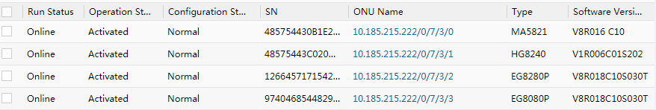
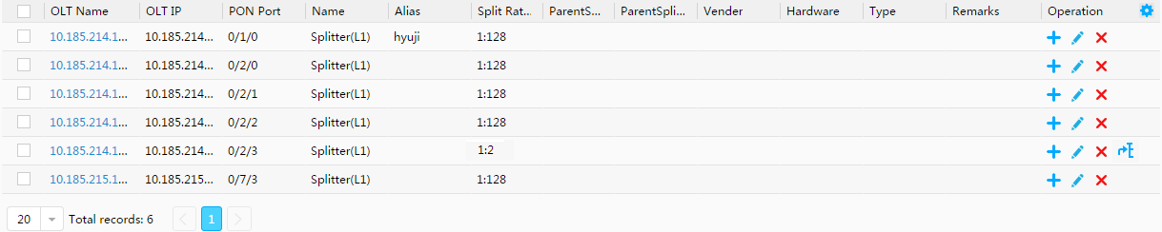
eSight PON Key Capabilities (2) - Resource Management (1)
The PON resource management function allows you to view the status of PON device resources and manage PON devices.
Status display
OLT list
ONU list
Splitter list
Notes:
eSight PON resource management provides unified management of network-wide PON device resources, including optical splitters, OLTs, and ONUs. Key service data is displayed in a centralized manner, helping users learn about network quality at any time.
OLT management:
The OLT list managed in the system is displayed in a resource table. Basic OLT information can be viewed, filtered, and queried.
This function supports operations such as synchronization, jumping to the physical topology, and clicking a name link to jump to the OLT device manager to review related details.
ONU management:
The ONU list managed in the system is displayed in a resource table. Basic ONU information can be viewed, filtered, and queried.
ONU resource management supports functions such as moving ONUs, changing alias, setting polling parameters, changing ONUs, and clicking an ONU name link to jump to the ONU manager to view related details.
Splitter management:
The optical splitter list managed in the system is displayed in a resource table. Basic optical splitter information can be viewed, filtered, and queried.
This function supports adding, moving, modifying, deleting, and batch importing optical splitters.

Slide 32
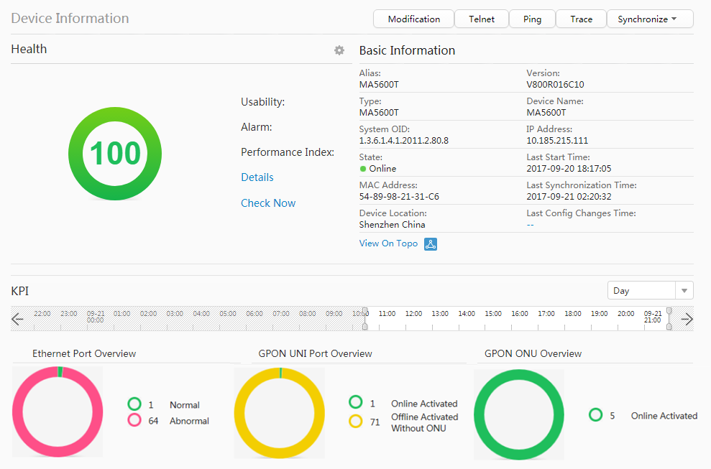
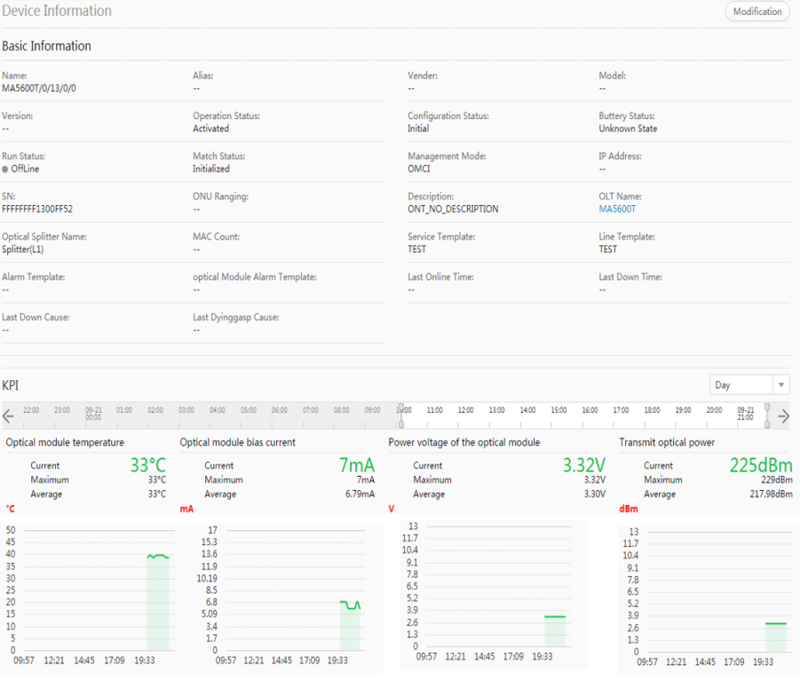
eSight PON Key Capabilities (2) - Resource Management (2)
Object Manager: Views OLT, ONU, and splitter details, such as basic information, health status, and KPIs.
OLT object manager
ONU object manager
Notes:
There are more KPIs, providing a full grasp of network maintenance.
PON electronic label: The electronic label list of PON devices is displayed in a resource table and can be exported.
Software version management:
This function supports operations such as viewing, uploading, modifying, and deleting device software versions.
A device software upgrade task can be created based on the upgrade option selected by a user and the software version file uploaded by the user. The created task list is displayed in a table. The task execution progress and status can be viewed.
Configuration file management and backup:
eSight can periodically (daily, weekly, or monthly) back up configuration files of devices specified in a backup task, at a specified time.
This function supports the operations of backing up the configurations of a specified device and restoring the configuration file for a specified device.

Slide 33
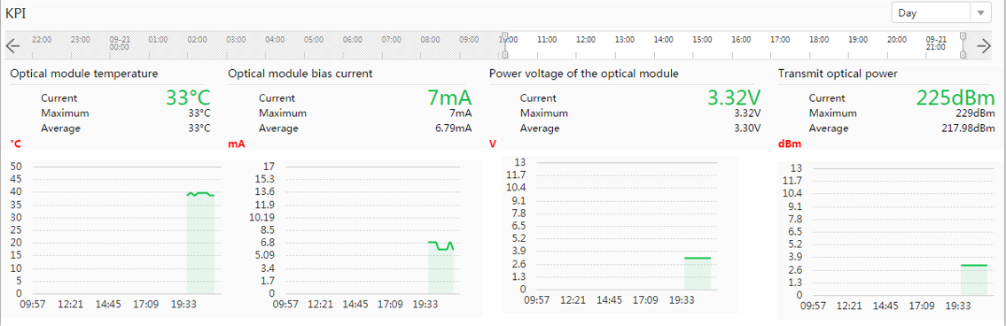
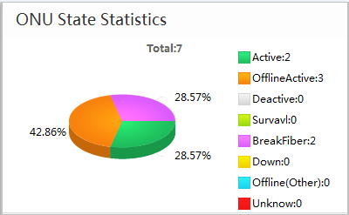
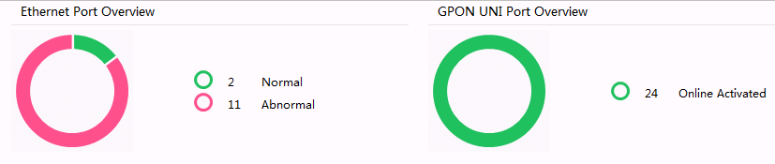
eSight PON Key Capabilities (3) - Network Monitoring (1)
GPON network monitoring: monitors device status and collects statistics on multiple performance indicators of devices, such as the CPU usage, memory usage, Ethernet port usage, and GPON UNI port usage. When a network fault occurs, O&M personnel can locate the fault based on the reported alarm information.
Device status monitoring
Notes:
Fast fault locating through GPON network monitoring:
OLT, ONU, and splitter list presented centrally, providing users one-stop access to equipment information
Device alarm information is centrally displayed. Analyses and determines the fault type and the device where the fault occurred based on the alarm name, alarm source, and location.

Slide 34
eSight PON Key Capabilities (3) - Network Monitoring (2)
eSight provides a variety of monitoring tools for GPON networks. Any faults are shown as alarms. You are advised to perform routine monitoring on GPON networks according to the following procedure.
……
Core switch
POS
Fiber
2
3
4
OLT
ODN
ONU/ONT
Twisted pair
1
5
OLT upstream port
ONU UNI
Notes:
Monitoring OLT upstream port: checks the link status between OLTs and upstream devices, packet transmitting/receiving rate of OLT upstream ports, and broadband utilization rate.
Monitoring OLT: OLTs are generally placed in equipment rooms and less prone faults. An OLT is more prone to board faults, which are reflected on the interface. You are advised to monitor the OLT's interface status.
Monitoring lines between ONUs and OLTs: The line faults are common faults on the GPON network. You are advised to check the status of each monitoring point and take preventive measures in advance.
Monitoring ONUs: ONU faults are mainly caused by power failure and board failures. You can monitor the ONU device status to check whether a power failure occurs, and the ONU user network interfaces (UNIs) to check whether a board failure occurs.
Monitoring ONU UNI:
End terminal faults account for 50% of all GPON network faults. However, eSight cannot directly monitor the status of end terminals. You can monitor the ONU UNIs to obtain the communication status between end terminals and ONUs.
eSight views the ONU UNI status through the ONU's NE manager or through the ONU topology.

Slide 35


eSight PON Key Capabilities (4) - Batch Upgrade
eSight PON supports wizard-based remote and fast software upgrade of PON devices in batches.
Select desired device version files or patch files.
1
Upload files.
2
Create an upgrade task in eSight.
Task type: OLT, MxU, and ONT upgrade; OLT and MxU patch installation
Task policy: scheduled or immediate upgrade
eSight
3
Perform the upgrade task.
ONU
...
POS
OLT
ONU
Notes:
You can manually upgrade UC devices to the same version in batches.
Add, modify, and delete versions by configuring upgrade versions.
Configure the upgrade object, type, and version using the upgrade wizard. eSight supports immediate upgrade and scheduled upgrade.
Monitor and manage the entire device upgrade process to view the upgrade progress, upgrade structure, and upgrade version.
Query detailed historical upgrade records.

Slide 36
eSight PON Key Capabilities (5) - Instant Availability After Replacement
eSight PON allows you to replace ONUs. When an ONU is faulty or cannot meet service requirements, the ONU can be replaced in a timely manner.
MxU
ONT
Device replacement
SN
SN of the new device
Device software upgrade
MxU configuration file
Retain the original configuration data.
Report ONU online notification.
ONU
...
eSight
OLT
POS
ONU
Notes:
Fast network recovery:
A maximum of 300 ONTs can be remotely upgraded in batches per hour, improving the upgrade efficiency.
For ONU replacement, MxU configuration files can be backed up so that new MxUs can inherit original configuration data, realizing fast network recovery and meeting service requirements.

Slide 37


eSight Deployment Mode (1) - Single-Server Mode
eSight can be deployed in single-server, hierarchical, and OSS integration modes.
eSight uses the B/S mode and allows simultaneous access from multiple web browsers.
Web browser
Web browser
Web browser
Web browser
Web browser
Web browser
Read/Write
MIB
Camera
eSight
PC
Fiber
Phone
Twisted pair
ONU
...
Telephone
OLT
POS
ONU
TV
Notes:
The eSight works in B/S mode.
The single-server system deployment solution uses multiple web clients and a single server. The web client and eSight server are connected through a LAN or WAN.
After logging in to the eSight infrastructure maintenance tool through a browser on a PC, users can manage and maintain the infrastructure management system server.
The eSight single-server system deployment solution applies to scenarios where the network scale is small and reliability requirements are not high.

Slide 38



eSight Deployment Mode (2) - Hierarchical Deployment Mode
eSight also supports hierarchical management to allow an enterprise headquarters to monitor networks in branches.
eSight professional
Firewall
eSight professional
eSight standard
Notes:
eSight also supports hierarchical management to allow an enterprise headquarters to monitor networks in branches.
In the hierarchical deployment mode, the upper-layer NMS can add the lower-layer NMS to the system and provide a link for opening the lower-layer NMS. When users click such a link, a new browser window is displayed, where you can log in to the lower-layer NMS.

Slide 39

eSight Deployment Mode (3) - OSS Integration Mode
eSight can integrate with the upper-layer OSS and report network alarms through SNMP to interconnect to the OSS.
OSS
Router
SNMP
DCN
Switch
eSight
OLT
Managed device
Notes:
An OSS is network management software running on the network management workstation. Network administrators operate the OSS to send requests to managed devices, so that they can monitor and configure these devices.
Integration with the OSS has the following advantages:
Improves the network management capability.
Separates NE management from network management.
Meets requirements of the enterprise O&M mechanism.

Slide 40
NMS Architecture
SNMP
Overview of Huawei Access NMSs
eSight
iManager U2000
NCE (Access Domain)

Slide 41
Background of iManager U2000
With the development of IT and IP technologies and the convergence of various industries (such as telecommunications, IT, media, and consumer electronic industries), the telecommunications industry has witnessed tremendous changes. Broadband services, mobile services, and network convergence have become the mainstream.
All-IP architecture trend, fixed mobile convergence (FMC) driving force, and network convergence are all factors that need to be considered during the development of network management. To follow the network development trend, U2000 implements All-IP and FMC management schemes to manage transport and access devices in a unified manner.
Network development and O&M management:
All-IP design is transforming existing technology/service-classified vertical networks into flattened horizontal networks.
The driving force of FMC is to improve user experience, reduce OPEX, and enhance efficiency.
Network convergence brings convergence of O&M management.
Notes:
To follow the network development trend, U2000 implements all-IP and FMC management schemes to manage transport and access devices in a unified manner.
U2000 not only integrates the management of multi-domain devices, but also achieves integration of NE-level management with network-level management, and revolutionizes the layer-based management mode to better meet the network management transition from vertical networks to flattened horizontal networks.
U2000 integrates multiple domains, minimizing O&M investment and improving network value.

Slide 42
Functions of iManager U2000
Huawei iManager U2000 is an integrated NMS for access and transport networks. It covers all devices and solutions of the network product line, is sold to global customers, and provides the most competitive All-IP and FMC O&M solutions in the industry.
Unified management of all network products
Unified management platform for network product solutions
Transport NEs
Access NEs
IP NEs
Security-domain NEs
...
Mobile service transmission
Broadband service transmission
Data core
Data RAN
Submarine cable
FTTX/DSLAM
MSAN
...

Slide 43
Telecommunications Management Network (TMN)
Network management functions
Alarm management
Service configuration
Charging management
Performance management
Security management
Business
Management Layer
OSS
Service Management Layer
Network Management Layer
Element Management Layer
Transmission network
MSTP/WDM/
RTN/Marine
Access Network
FTTx/DSLAM/
D-CCAP/MSAN
IP network
Router/Switch/
PTN/ATN/BRAS
Network device layer
Notes:
TMN: Telecommunications Management Network
With the development of the scale and complexity of telecommunications networks, the network management system plays an increasingly important role in improving the network service quality, managing network resources, and reducing network management costs.
To implement unified, simple, and standardized management, ITU-T proposed the TMN concept. The purpose is to support the planning, configuration, installation, operation, and organization of telecom networks and telecom services.
TMN functions are classified into the following layers in ascending order:
Network equipment layer: consists of certain physical NEs and uses the local craft terminal (LCT) as its management software.
NE management layer: configures and manages NEs in a centralized manner.
Network management layer: manages all NEs in the managed area. It applies to large-scale and geographically dispersed network management. The main functions include coordinating and controlling activities of all NEs from a network-wide perspective, provisioning, modifying, or terminating a network service, and interacting with the service management layer on matters such as network performance and availability.
Service management layer: provides complete service operation and management, including service lease, bandwidth wholesale, and VPN.
Transaction management layer: executes business-related functions, analyzes development trend such as quality issues, and provides accounting basis and other financial reports.

Slide 44
Position of U2000 in the TMN Standard
OSS
Fault
Inventory
Service Provision
Performance
Diagnosis
Service management layer
XML/CORBA/SNMP/FTP/TL1/line test/RESTCONF/OMC
Service management layer
+
NE management layer
iManager U2000 unified network management system
Network device layer
Transmission network
MSTP/WDM/
RTN/Marine
Access Network
FTTx/DSLAM/
D-CCAP/MSAN
IP network
Router/Switch/
PTN/ATN/BRAS
Notes:
U2000 is located at the NE management layer and network management layer in the TMN and supports all NE-level and network-level management functionality.
U2000 is a typical solution for unified management of network products.
U2000 provides a unified management platform for access, transport, and IP devices. This platform implements unified management of not only cross-domain devices, but also the network layer and NE layer, which offers more openness than the vertical management mode. In addition, U2000 supports permission- and domain-based management. This feature enables U2000 to manage the devices in each domain separately to meet the requirements for managing different networks and departments without affecting each other.
U2000 meets the network convergence trend and offers management solutions for various networking scenarios. U2000 has a unified GUI style, which is simple and convenient for service provisioning. The highly effective service monitoring and service assurance ensure good user experience and reduce the network O&M cost effectively.
Unified NBIs greatly reduce OSS integration workload.

Slide 45


Application of the iManager U2000 on an FTTx Access Network
Network deployment:
Fast deployment of ONUs
Fast deployment and remote acceptance of MDU services
Service provisioning:
Automatic provisioning through the OSS
Excel-based service provisioning
FTTx service provisioning template
Network maintenance:
FTTx topology management, service query and diagnosis
MDU PnP after replacement and automatic batch upgrade of ONTs
2. Report the MAC address or SN of the new MDU.
3. Associate the MAC address or SN of the new MDU.
5. Configure automatic software version recovery.
1. Replace the MDU onsite.
4. Register automatically after power-on.
MDU
OLT
MDU PnP after replacement
Notes:
In the FTTx access network application, U2000 provides three functions: network deployment, service provisioning, and network maintenance.
Network deployment:
Fast ONU deployment: ONU deployment and remote software commissioning are automatically completed based on the ONU PnP policy.
Fast deployment and remote acceptance of MDU services: Service pre-configuration based on an Excel file enables PnP of MDUs that use PON ports for upstream transmission. No site visit is required and the results are automatically reported, reducing O&M costs.
Flexible and efficient FTTx service provisioning:
Automatic service provisioning from the OSS
Batch provisioning based on a pre-deployment Excel file
One-click service provisioning based on an FTTx service provisioning template
Network maintenance:
FTTx topology management and FTTH hierarchical service assurance
FTTB/FTTH E2E service view and diagnose
Fast service recovery: MDU PnP after replacement, PON port service cutover
ONT automatic batch upgrade

Slide 46
NMS Architecture
SNMP
Overview of Huawei Access NMSs
eSight
iManager U2000
NCE (Access Domain)

Slide 47
Network Evolution - SDN
NCE Overview
NCE Deployment
NCE Common Functions
NCE (Access Domain) Enhanced Functions
Software Defined Network (SDN) enables networks to be as agile as software.
Three characteristics of SDN:
Separation of the control plane and forwarding plane
Centralized control plane
Network programmability
The core of SDN network architecture is the SDN controllers introduced in the network, which realizes the separation of the control plane and forwarding plane and centralized control. The SDN controllers are the brain of a network and controls all devices. The controlled devices become forwarders, which are responsible only for forwarding. Forwarding instructions are sent by the SDN controllers.

Slide 48


Evolution of Huawei's Smart Platform
NCE Overview
NCE Deployment
NCE Common Functions
NCE (Access Domain) Enhanced Functions
Software-defined Network
Intent-Driven Network
OSS
Service Orchestrator
OSS
Service Orchestrator
OSS
Service Orchestrator
Big data analysis
Unified open gateway
Openness and programmability
EMS/NMS
(U2000)
SDN
Controller
Management
Control
Management
Control
Analytics
(Big data & AI)
Centralized control plane
Unified cloud platform
Unified cloud platform
Telemetry
Traditional network
SDN network
Traditional
network
SDN network
Traditional
network
SDN network

Slide 49

What Is NCE?
NCE Overview
NCE Deployment
NCE Common Functions
NCE (Access Domain) Enhanced Functions
Orchestrator/OSS
Network Cloud Engine (NCE) is an innovative network cloudification engine of Huawei. Positioned as the brain of the future cloud-based network, NCE integrates functions such as network management, service control, and network analysis. It is a core enabling system for network resource pooling, network connection automation and self-optimization, and O&M automation.
NCE is located at the management and control layer of the cloud network. On the one hand, it manages and controls lower-layer network devices including IP, transport, and access devices. On the other hand, it opens capabilities and enables services to the upper layer to support interconnection and integration with the OSS, BSS, and service orchestrators, and support quick customization and development of the application layer.
The goal of NCE is to build an intent driven network (IDN) that implements network automation, network self-adaptation, and finally network autonomy.
Operator
Application package
Portal
Open API Gateway
Commercial application
(2B/2C/2H)
O&M application
Private line provisioning
Private line assurance
IP + Optical
SmartWi-Fi
Cutover
Optimization
...
Basic package
Manager
Controller
Analyzer
Platform package
Unified cloud platform

Slide 50
Product Form of NCE
NCE Overview
NCE Deployment
NCE Common Functions
NCE (Access Domain) Enhanced Functions
Unified "Manager+Controller+Analyzer" architecture, on-demand deployment
NCE
Infrastructure that allows flexible product combination and on-demand deployment.
NCE (IP Domain/Transport Domain/Access Domain/Super) can be presented as individual products to customers.
The management, control, and analysis components can be deployed on demand.
Portal
API
Management
Control
Analytics
Multi-layer/multi-domain connection management
Multi-layer, multi-domain control
Real time
awareness
In-depth
analysis
Smart
Prediction
Access domain
Optical domain
IP domain
Control
Optical domain
Control
IP domain
Cloud Native Platform
IP network management and control
Optical network management and control
Access network management and control
NMS scenario
Independent controller
Independent analyzer
NCE (IP Domain)
NCE (Transport Domain)
NCE (Access Domain)
NCE (Super)
AC-DCN/
AC-Campus
FabricInsight

Slide 51
NCE Deployment Scenarios
NCE Overview
NCE Deployment
NCE Common Functions
NCE (Access Domain) Enhanced Functions
Based on whether Huawei provides E2E support for software and hardware, NCE supports two deployment modes: on-premises and private cloud.
In on-premises deployment scenarios, Huawei provides both software and hardware, that is, Huawei delivers the hardware and software required for NCE deployment and completes E2E software and hardware configuration.
Huawei deployed
Customer deployed
NCE deployment scenarios
Application
Application
Application
Database
Database
Database
On-premises
Private cloud
OS
OS
OS
Physical machine deployment
Virtualized deployment
Private cloud (OS+product)
Private cloud (product only)
Virtualization
Virtualization
Virtualization
Server
Server
Server
Factory installation
Onsite installation
FC KVM:
OS (VHD) one-click installation
OS provided by customers (SUSE)
OS installed by customers
Storage
Storage
Storage
Network
Network
Network
FusionSphere OpenStack:
OS (qcow2) manual installation
Private cloud (OS+product)
Private cloud (product only)
On-premises
Notes:
On-premises: Huawei engineers configure the hardware, virtualization environment (not required for physical machine deployment), OS, database, and NCE software in an end-to-end (E2E) manner. The installation takes less than 4 hours.
Private cloud (OS+product): After the customer configure the FusionCompute KVM or FusionSphere+CSM virtualization environment, Huawei engineers create a VM, and install the OS, database, and NCE software. The installation usually takes less than 3 hours.
Private cloud (product only): After the customer configures the virtualization environment, Huawei engineers install the database and NCE software. The installation takes less than 2.5 hours.

Slide 52
Deployment View
NCE Overview
NCE Deployment
NCE Common Functions
NCE (Access Domain) Enhanced Functions
TaiShan physical machine
Private cloud (OS+product)
Private cloud (product only)
Application layer
Portal
API
Management
Multi-layer/multi-domain connection management
Access domain management
IP domain management
Optical domain management
With the Cloud Native microservice-based architecture, each functional node can be deployed on demand based on user scenarios to flexibly meet service requirements.
Database layer
GaussDB
OS layer
EulerOS
Compatible versions
EulerOS
SUSE Linux Enterprise Server
SUSE Linux Enterprise Server
Hardware layer
Compatible versions
VMware vSphere
FusionCompute
-------------------
FusionSphere
CloudOpera CSM
2288H V5 server
CPU: 2 x Gold 6138T (2.0 GHz, 20 cores)
Memory: 4 x 32 GB
Hard disk: 8 x 600 GB SAS HD hard disks (10K KPM)
RAID card: Avago3508 (2 GB cache)

Slide 53
NCE Deployment Process
NCE Overview
NCE Deployment
NCE Common Functions
NCE (Access Domain) Enhanced Functions
Use EasySuite for planning.
Prepare for installation.
Install and commission NCE.
Verify NCE after installation and commissioning.
Download EasySuite
and log in.
Prepare the installation environment (software and hardware and network configuration).
Use EasySuite
to install NCE.
Check service status.
Create a matching project.
Commission NCE.
Use EasySuite to
plan installation data.
Download and verify the software package and apply for a license.
Notes:
EasySuite is a portable web-based engineering tool provided by Huawei. It covers complex engineering scenarios such as planning, installation, and migration. Using EasySuite to install NCE greatly simplifies installation and deployment operations and improves efficiency.

Slide 54
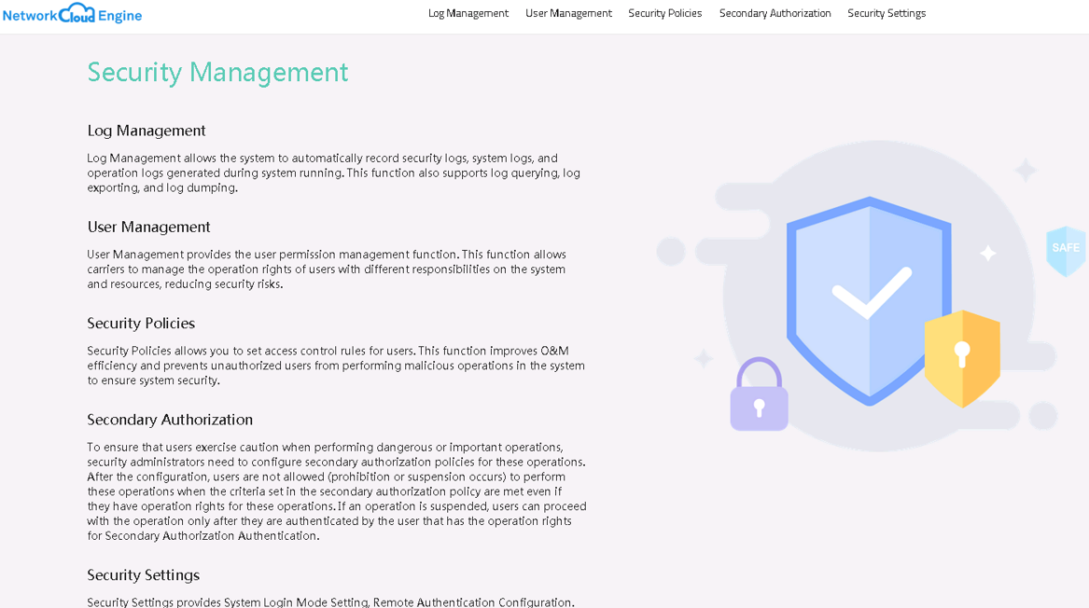
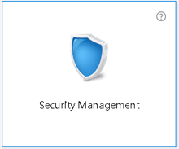
UI Style of NCE Apps
NCE Overview
NCE Deployment
NCE Common Functions
NCE (Access Domain) Enhanced Functions
After you open each app, only the menu items used by this app are displayed. Clicking a menu item will change the function area.
A return button is provided on the left of the main menu of each app for you to return to the home page.

Slide 55
NCE UI Types and Login
NCE Overview
NCE Deployment
NCE Common Functions
NCE (Access Domain) Enhanced Functions
NCE provides two independent working interfaces on different planes: management plane and O&M plane. You can log in to each plane through a specific IP address and port number. This helps you focus on your own task scenarios to ensure efficient system management and network O&M.
Type | Target Audience | Function | Login Method
Management plane | Installation and commissioning engineers System administrators | Centrally manages NCE resources, applications, and databases to implement functions such as installation and deployment, system monitoring, system maintenance (user and password management, data backup and restore, and certificate and key management), and system troubleshooting (system health check, fault data collection, fault demarcation and locating, and disaster recovery). | https://management plane IP address:31945
O&M plane | System security administrators Network O&M engineers | Provides the following features and functions for O&M scenarios such as network planning/deployment, service design/provisioning/analysis, network monitoring/analysis/adjustment/maintenance/troubleshooting of transport, IP, access, and multi-layer networks: system configuration (such as license management, interconnection with the southbound systems), security management (user management, permission management, security policy, and log management), alarm management, network management, premium WDM private line, key service assurance, network survivability analysis, OTN virtual private network, What-If analysis, and network analysis and optimization. | https://O&M plane IP address:31943
Notes:
Replace management plane IP address with the client login IP address configured on the OMP node. If the OMP node is deployed in a cluster, the IP address is set to the floating IP address of the cluster.
Replace the O&M plane IP address with the client login IP address configured on the service node. If the service node is deployed in a cluster, the IP address is set to the floating IP address of the cluster.
NCE provides the default user admin. The initial password of this user is Changeme_123. For security purposes, change the password periodically and keep it secure. If the password for the admin user is lost, you can only reset the password by reinstalling the management plane. To ensure system security, do not let the browser to remember the password.

Slide 56
Serviceability Functions of NCE
NCE Overview
NCE Deployment
NCE Common Functions
NCE (Access Domain) Enhanced Functions
Fault monitoring
Fault diagnosis
Fault rectification
Upgrade/patch installation
Core functions:
O&M dashboard
Unified monitoring
Alarms
Health check
Core functions:
Fault analysis
Replicated fault identification
Information collection
Core functions:
DR switchover
Starting and stopping services
Backup and restoration
Planned restoration
Optional step. Install a patch based on whether the fault is caused by a quality problem.
The preceding flowchart shows the typical E2E maintenance process of O&M personnel on the live network.
Fault monitoring: Detects and exposes system faults in advance with unified monitoring, health check, O&M dashboard, and alarms.
Fault diagnosis: If a fault is detected and is not rectified automatically, quickly performs an online preliminary fault analysis based on the fault scenario and symptom, and performs subsequent operations based on fault demarcation and locating. If the system cannot diagnose the fault or the fault scenario is not supported in current version, collects related information in one-click mode and contact Huawei technical support.
Fault rectification: After a fault is demarcated and located and the root cause is analyzed, starts fault rectification immediately with a DR switchover, starting/stopping services, planned restoration, or restoration by emergency scripts.
Upgrade/patch installation: If the problem is caused by quality problems, you need to install a patch to completely rectify the problem based on the patch release plan.

Slide 57
HA Capability: Remote DR
NCE Overview
NCE Deployment
NCE Common Functions
NCE (Access Domain) Enhanced Functions
NCE
Third site
The arbitration mechanism is introduced to improve decision-making accuracy. No arbitration is required in the centralized deployment scenario of NCE Manager.
DRMgr
Arbitration
Status detection and automatic switchover
Replication management
Automatic or manual switchover
RTO ≤ 15 min
RPO ≤ 60s
Monitoring management
Active site
DR
DR
Standby site
Switchover management
DRMgr
DRMgr
NCE DB
Heartbeat
Service 1
DB
DB
Service 1
Linux
Service 2
Service 2
Asynchronous replication RPO ≤ 60s (service data of Manager and Controller)
VM
.
.
.
.
.
.
Service n
File
File
Service n
Hypervisor
Business service
Business service
Data
Network delay < 50 ms; Packet loss rate < 0.1%
Data
*You are advised to use redundant private lines for replication. The switchover time is less than 1s.
Remote DR based on database replication is located at the application layer and does not depend on specific hardware or virtualization platforms.
Management Scale (Equivalent NEs) | 6000 | 15,000 | 30,000
Minimum Bandwidth Between the Primary and Secondary Sites (Excluding Analysis Data) | 60 Mbit/s | 100 Mbit/s | 200 Mbit/s
Notes:
HA: High Availability An HA cluster is a group of computer systems that jointly provide network resources for clients.
RTO: Recovery Time Objective
DRMgr is Huawei's HA management software.

Slide 58
Interfaces Between NCE and Other Systems
NCE Overview
NCE Deployment
NCE Common Functions
NCE (Access Domain) Enhanced Functions
Service provisioning, alarm, performance monitoring
OSS/BSS/Orchestrator
Smartphone app SDK
REST/XML/
CORBA/SNMP/Text/TL1/Syslog
REST/Web socket
Authentication, authorization, and accounting
AAA
Radius
Network Cloud Engine
Script
OptiX NetStar
Script/XML
IBMS
REST/Qx/SNMP/NETCONF/
TFTP/FTP/SFTP/Telnet/STelnet/
OSPF/OSPF-TE/PCEP/BGP-LS/
BGP FlowSpec/BGP RPD/MQTT/NetStream/Telemetry
REST
REST
Managed third-party controller
Managed device
Cloud management system (FusionSphere)

Slide 59
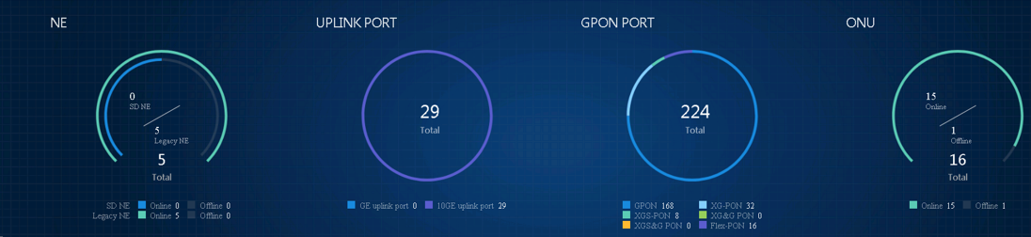
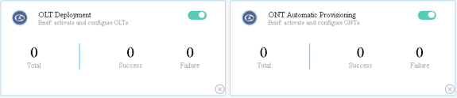
Introduction to the Access Controller App
NCE Overview
NCE Deployment
NCE Common Functions
NCE (Access Domain) Enhanced Functions
Access controller: provides the automation capability for access devices and preferentially builds automation capabilities for SD-OLTs, including automatic installation and deployment (OLT ZTD), automatic service provisioning (ONT ZTP), and automatic network adjustment (device replacement and service cutover).
NM retains the original U2000 functions and provides FCAPS functions such as configuration management and alarm monitoring for devices. The NE model is used as the managed object model. The management scope includes SD-OLTs and traditional OLTs. To communicate with SD-OLTs, the original U2000 functions of NM are still implemented through SNMP.
Access Controller provides the following functions:
Network inventory dashboard
Automatic OLT deployment (OLT ZTD)
Automatic ONT service provisioning (ONT ZTP)
Pre-deployment of ONT service provisioning (ONT ZTP)
Notes:
Access Controller provides the following functions:
Network inventory dashboard: NE statistics view (SD and legacy NEs); optical network statistics views for access resources including GPON ports, upstream ports, and ONTs.
Automatic OLT deployment (OLT ZTD): NETCONF/YANG NEs support TR301-compliant automatic Call Home to NCE, which provides initial configurations after an OLT goes online.
Automatic ONT service provisioning (ONT ZTP): For NETCONF/YANG and SNMP NEs, the ONT whitelist and service provisioning packages are preconfigured. When an ONT goes online, the ONT is automatically authenticated and services are provisioned based on preconfigured policies.
Pre-deployment of ONT service provisioning (ONT ZTP): In a market that replaces copper with fiber, a copper line network (unlike an optical network) does not require ONT management. To reduce ONT management on the OSS, ONTs are planned and initial service configuration is completed in advance in the initial network configuration. After an ONT goes online, the ONT is activated based on the whitelist.
Traditional OLT (legacy NE): Only SNMP management is supported.
SD-OLT (next-generation OLT): Supports both NETCONF protocol and SNMP management and fully inherit SNMP management capabilities of traditional OLTs.

Slide 60

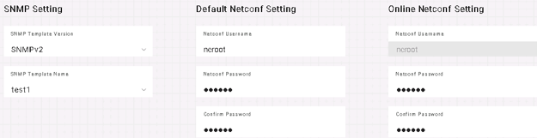

Automatic NE Deployment (OLT ZTD) - New Deployment
NCE Overview
NCE Deployment
NCE Common Functions
NCE (Access Domain) Enhanced Functions
OLT ZTD Pre-configuration (One-time Configuration)
OLT ZTD NE go-online process
Entry | Item
NCE | Enable ZTP, initialize the script (JSON template), configure the default SNMP template, and set NETCONF authentication parameters after a device goes online.
DHCP | Configure DHCP Option 1 (mask of the temporary IP address), 3 (gateway), and 125 (IP address of NCE) and enable DHCP relay.
OSS | OLT ESN list. The OSS assigns NE names and NE IP addresses based on the device ESNs.
OSS
4
Obtain the formal IP address, subnet mask, gateway, NE name, and AccessIDPrefix.
To configure a JSON configuration script template, open the Access Controller app, click More Settings, and then click Configuration Template.
NCE
WKE
Nemgr
ZTP
BAA
DHCP Server
To configure authentication information, open the Access Controller app, and choose OLT ZTD > Activation Process Settings.
NCE adds an NE and delivers and synchronizes configuration data.
5
3
Initiate a Call Home.
2
Obtain the temporary IP address and BAA address.
OLT (MA58xx series)
1
Install and power on the device, and configure upstream cascading.
Interfaces (RESTful) required by the OSS: OLT auto-discovery interface, OLT IP address assignment interface
Notes:
ZTD indicates zero touch deployment. During OLT installation and deployment, hardware engineers only perform hardware-related operations and do not need to have software commissioning skills. Software commissioning engineers do not need to configure data of new devices in the network center or on site, saving manpower in onsite or remote software commissioning.
For details about restrictions and conditions, see the product documentation.

Slide 61
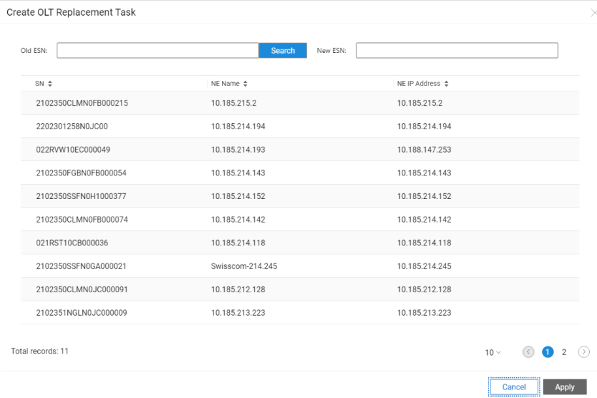

Automatic NE Deployment (OLT ZTD) - Replacement
NCE Overview
NCE Deployment
NCE Common Functions
NCE (Access Domain) Enhanced Functions
0
Create an OLT replacement task on the NCE UI.
OSS
Browser
DHCP
6
NOC: Remotely restore NE configurations using the DC.
5
Notify the OSS.
4
NCE executes the NE replacement process: Restore the management channel (SNMP and NETCONF channels).
NCE
WKE
Nemgr
ZTP
BAA
DCN
3
Initiate a Call Home.
2
Obtain the temporary IP address and BAA address.
Replace the entire device. Note: The software version of the replacement NE must be consistent with that of the replaced one.
OLT (MA58xx series)
1

Slide 62
Automatic ONT Deployment (ONT ZTP)
NCE Overview
NCE Deployment
NCE Common Functions
NCE (Access Domain) Enhanced Functions
Background: Traditional networks use copper lines. During FTTH service deployment, carriers expect that the end user side and CRMs do not need to be changed for service provisioning. The change from copper to fiber is limited between service provisioning systems (OSS system Netcracker and NCE). There are the two ONT ZTP solutions based on whether ONTs are planned and configured during OLT deployment.
1. ONT pre-deployment solution
2. On-demand ONT deployment solution
OSS
(service provisioning system)
OSS
(service provisioning system)
6
Notify the OSS that the ONT is online.
Import the ONT whitelist to NCE. Pre-configure templates and service packages.
3
Bond ONTs to service packages.
2
Import the ONT whitelist.
2
5
Change ONT SNs to online SNs.
Activate ONTs.
6
Add new online ONTs and configure service ports based on service packages.
NCE
NCE
4
Authenticate ONTs on the cloud.
5
Authenticate ONTs on the cloud.
1
Perform only basic configurations, such as management channel, board hardware, and global system parameters during OLT deployment.
Preconfigure all ONTs and service ports in offline mode during OLT deployment.
Set ONT SNs to virtual SNs.
3
Automatically discover online ONTs.
1
4
Automatically discover online ONTs.
Notes:
For details about restrictions and conditions, see the product documentation.

Slide 63
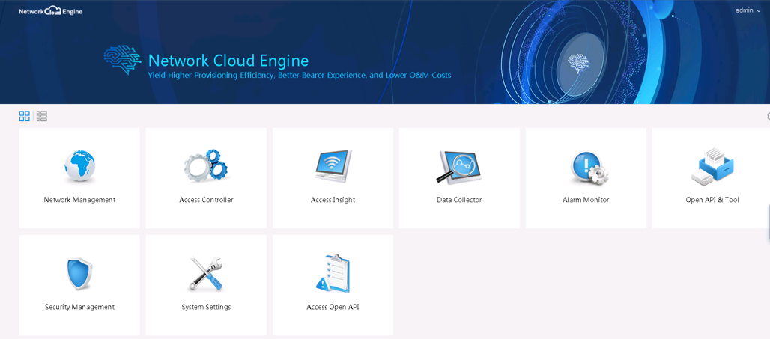
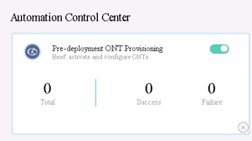
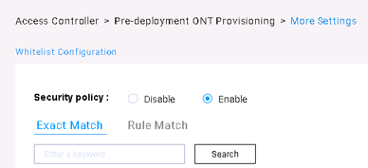
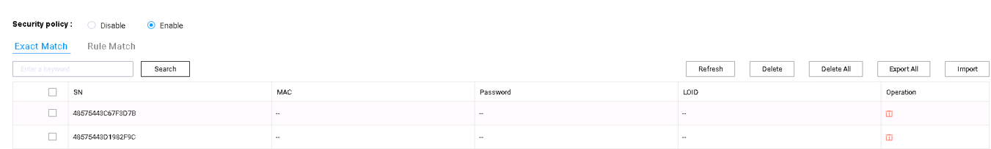
ONT ZTP – Whitelist Import
NCE Overview
NCE Deployment
NCE Common Functions
NCE (Access Domain) Enhanced Functions
NCE compares the ONT information (SN, LOID, and password) reported by the OLT with that in the whitelist. If they match, the ONT passes the authentication, and continues to automation.
Entry: Functions related to ONT ZTP and OLT ZTD can be found in the standalone Access Controller app.
Notes:
Whitelists can be imported in CSV format.

Slide 64
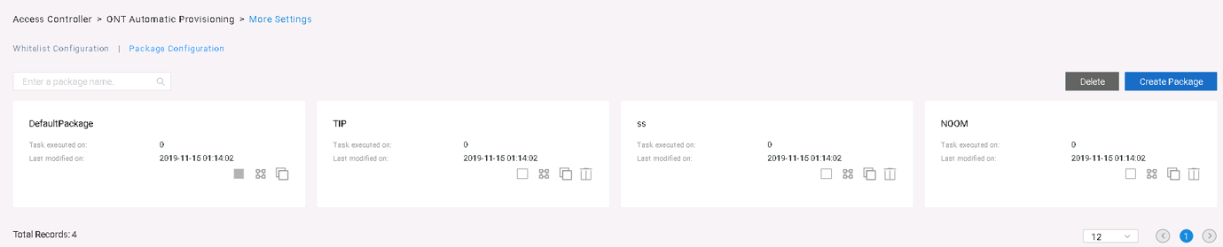
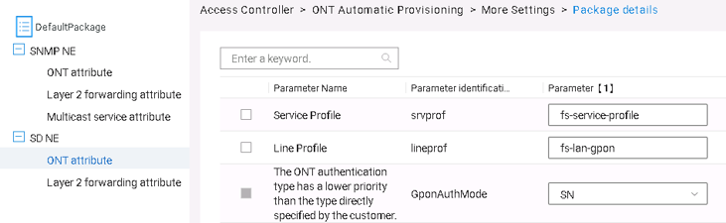
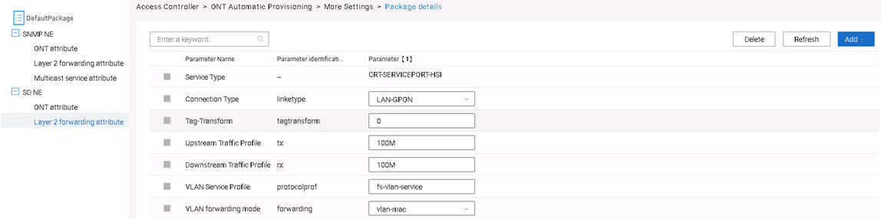

ONT ZTP – Package Configuration
NCE Overview
NCE Deployment
NCE Common Functions
NCE (Access Domain) Enhanced Functions
In the on-demand ONT deployment scenario, services to be provisioned by an ONT must be defined through package configuration after the ONT goes online.
ONT ZTP package: common attributes of related service flows after the ONT goes online, such as the VLAN service profile, RAIO profile, ONT line profile, ONT service profile, and VLAN forwarding mode.
Defining a service package after an ONT goes online
ONT basic attribute configuration
Description:
A package is used together with the service-level northbound API. The service-level northbound API calls the parameters defined in the package through orchestration for NE configuration.
Service packages for SNMP NEs and NETCONF/YANG NEs (SD NEs) are defined separately. The same type of package provides different capability sets for the two types of NEs.
By default, SNMP NEs support the configuration of ONTs, service flows, and multicast attributes, while SD NEs support the configuration of ONTs and service flow attributes.
The package allows parameter addition (Add Row) when the service-level API supports new services.
Operations supported on the GUI: Adding, deleting, or copying a package; adding and saving parameters
In the ONT pre-deployment scenario, users do not need to define and use packages.
Service flow attribute configuration

Slide 65
(True or false) If a device can be managed by eSight and the device status can be viewed, but device parameters cannot be set on eSight, the write community names of the device and eSight may be different. ( )
True
False
Notes:
Answer:
A

Slide 66
SNMP principles
Overview of eSight_PON network device management
eSight deployment modes
iManager U2000 deployment overview
NCE (Access Domain) deployment overview

Slide 67
eSight Planning Guide
eSight Hardware Installation Guide
eSight Software Installation Guide
License User Guide
eSight Upgrade Guide
eSight Patch Installation Guide
Path for obtaining the preceding files on https://support.huawei.com/enterprise/: Support > Management System > eSight Unified ICT Management System > eSight > Installation & Upgrade

